Slide 1
Book Recommender System

Slide 2
Objective:
Develop book recommender machine learning application, that can recommend books to the users according to their interest.
Benefits:
Users can make more choices on reading the books.
Enhance user experience in searching and exploring of books.

Slide 3
Data Sharing Agreement :
Sample file name (ex fraudDetection_20062021_101010)
Length of date stamp(8 digits)
Length of time stamp(6 digits)
Number of Columns
Column names
Column data type

Slide 4
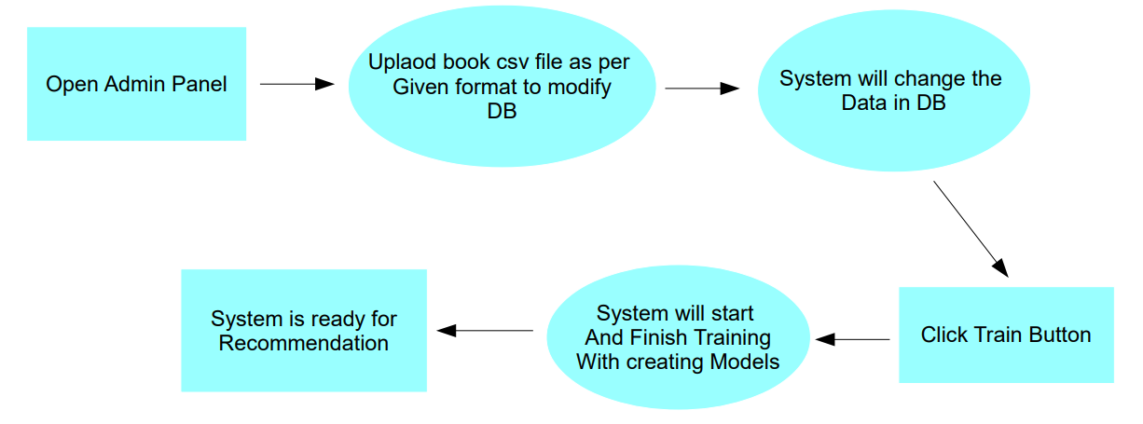
Admin Architecture

Slide 5
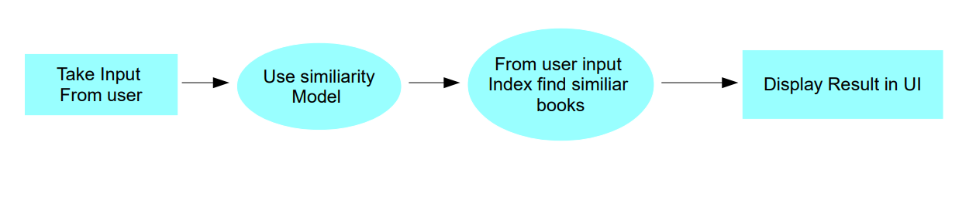
Homepage Architecture

Slide 6
Data Validation and Data Transformation :
Null values in columns - replace null values to empty string and store it into database
Before Training apply stemming on dataset, so model will train reliably. Ex: `dancing`, `danced` will be converted to `danc`
Before Training remove stop words like `and`,`the` so model training accuracy can be increase.

Slide 7
Data Insertion in Database:
Cassandra database is used for data operation.
Admin can modify data by uploading csv file with appropriate structure.
Model training and recommendation will use data which are inserted in database.

Slide 8
Model Training:
Data Export from Db :
Make dataframe by selecting data from database.
Data Preprocessing
We have already handle null values when insert data in database
Create tags from required features..
Applying NLP operation on tags describe above.

Slide 9
Text Vectorization
Text vectorization method use for building Machine Learning Model.
Cosine Similarity
We are building model such a way that, model can represent cosine similarity for all data.
Recommendation
User will input book data, and system will recommend books based on
that model.

Slide 10
Q & A:
Q1) What’s the source of data?
The data for training is provided by the client in multiple batches and each batch contain multiple files
Q 2) What was the type of data?
The data was the combination of numerical and Categorical values.
Q 3) What’s the complete flow you followed in this Project?
Refer slide 4th for better Understanding

Slide 11
Q 4) How logs are managed?
We are using different logs as per the steps that we follow in validation and
modeling like File validation log , Data Insertion ,Model Training log , prediction log
etc.
Q 6) What techniques were you using for data pre-processing?
Removing unwanted attributes
Visualizing relation of independent variables with each other and output variables
Cleaning data and imputing if null values are present.
NLP operations

Slide 12
Q 7) How training was done or what models were used?
Refer slide no 8 and 9
Q 8) How Recommendation was done?
Recommendation was done by calculating cosine distance of tags vectors

Slide 13
Q 9) What are the different stages of deployment?
After testing the application, deployed on heroku, with setting up cassandra drivers and all required package on server by specifying requirement.txt in project.

